Slide 1
Going Cross Platform with Kotlin
Jenifer Cochran
Software Developer
FOSS4G St. Louis
Jenifer.Cochran@rgi-corp.com

Slide 2

About Me
High School Math Teacher turned developer
Software developer at RGi for 3+ years
Soccer Captain/Coach to Team Merkator
First time presenter at FOSS4G
Enjoys puns and dad jokes
Slides & Code: https://github.com/GitHubRGI/FOSS4G-StLouis-2018
Notes:
Just a little about me before we get started.
I started out as a High School Math Teacher, and I didn’t like it so I looked for another outlet to apply Math. I started as a software developer intern at Rgi and have loved my new career ever since.
I have been working as a developer at RGi for over 3 years now. Doing mostly Java and C# work but I had the opportunity to do some Kotlin work. And I would like to share what I have learned from that experience. This is my first time presenting at FOSS4G!

Slide 3
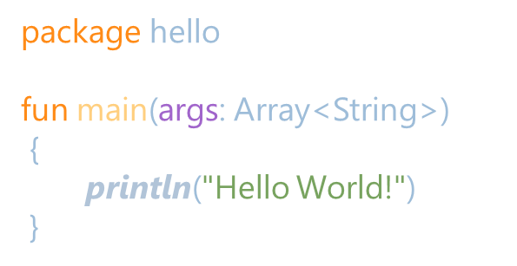
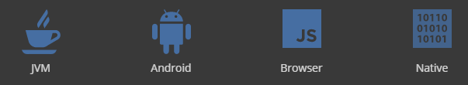
What is Kotlin
Statically typed programming language for multiplatform applications
Slides & Code: https://github.com/GitHubRGI/FOSS4G-StLouis-2018
Notes:
Kotlin is a programming language that is designed in a way that can create multiplatform projects.

Slide 4

Why choose Kotlin?
Tool Friendly
Concise
Safe
Interoperable
Slides & Code: https://github.com/GitHubRGI/FOSS4G-StLouis-2018
Notes:
There are many reasons to choose Kotlin:

Slide 5
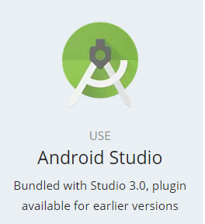
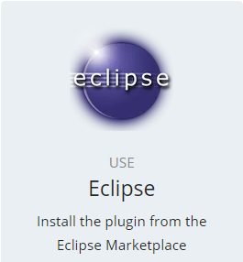

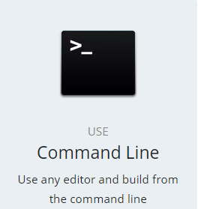
Tool Friendly
Slides & Code: https://github.com/GitHubRGI/FOSS4G-StLouis-2018

Slide 6
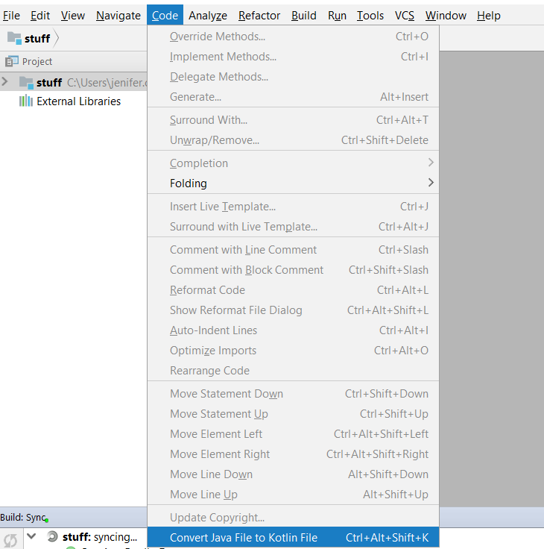
Interoperability Tools
Java to Kotlin converter tool
Built into Intellij
Typescript to Kotlin converter tool
https://github.com/Kotlin/ts2kt
Slides & Code: https://github.com/GitHubRGI/FOSS4G-StLouis-2018

Slide 7
Interoperable
Java
Java and Kotlin are 100% compatible
Call Kotlin from Java
Call Java from Kotlin
Javascript dependencies can be pulled into Kotlin (More on how later)
Call Inline Javascript from Kotlin
Otherwise known as a bad idea
Kotlin can be exported as a .jar, .js, .apk
public class Customer
{
private String firstName;
private String lastName;
// standard setters and getters
}
Kotlin
val customer = Customer()
customer.firstName = "Frodo"
customer.lastName = "Baggins"
Slides & Code: https://github.com/GitHubRGI/FOSS4G-StLouis-2018
Notes:
NOTE THAT THERE ARE IMPLICIT GETTERS AND SETTERS IN THIS JAVA CLASS

Slide 8
Types of Modules
.js
.class
Common
exports
Types of Modules
Common Module
Platform Module
Regular Module
(.kt)
Kotlin-JS
Kotlin-JVM
exports
.js
exports
.class
(.kt, .js)
(.kt, .java)
web
android
backend
Slides & Code: https://github.com/GitHubRGI/FOSS4G-StLouis-2018
Notes:
A common module contains code that is not specific to any platform, as well as declarations without implementation of platform-dependent APIs. Those declarations allow common code to depend on platform-specific implementations.
A platform module contains implementations of platform-dependent declarations in the common module for a specific platform, as well as other platform-dependent code. A platform module is always an implementation of a single common module.
A regular module. Such modules target a specific platform and can either be dependencies of platform modules or depend on platform modules.
Regular modules you want to include-> web, android, backend
File types allowed in Common, Kotlin-JS, Kotlin-JVM
Exports for Common Module, Kotlin-JS module, Kotlin-JVM module

Slide 9
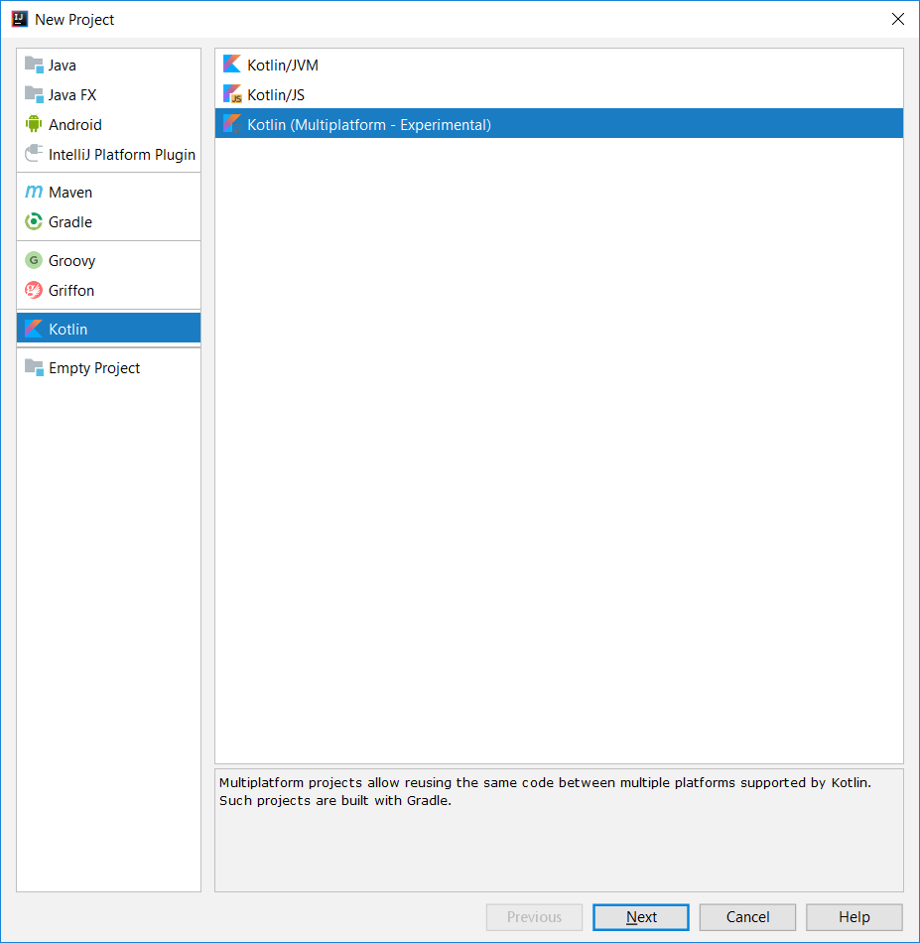
Intellij sets it up for you!!!! phewwwww
Slides & Code: https://github.com/GitHubRGI/FOSS4G-StLouis-2018

Slide 10
Common Module
Kotlin Standard Library
Collections and sequences
Functional operations on collections (filter, map, etc)
Higher-order utility functions (with, apply, etc)
Exception
Testing
Higher-level infrastructure libraries
Slides & Code: https://github.com/GitHubRGI/FOSS4G-StLouis-2018

Slide 11
How do you build connections between Common Module and the Platform specific code?
Slides & Code: https://github.com/GitHubRGI/FOSS4G-StLouis-2018

Slide 12
Keywords expect & actual
Common Module
Expect keyword
Defines what the Common Module expects to use
Like Java’s abstract class
No implementation needed in expect
Actual keyword
Implementation in the Platform Specific Module
Package names must match
package org.jetbrains.foo
expect class Foo(bar: String)
{
fun frob()
}
Common Module’s main class
fun main(args: Array)
{
Foo("Hello").frob()
}
Slides & Code: https://github.com/GitHubRGI/FOSS4G-StLouis-2018
Notes:
We will discuss two different ways to build connections using the Expect and Actual Keyword

Slide 13
Example 1: Connection to Common Module
package org.jetbrains.foo
actual class Foo actual constructor(val bar: String)
{
actual fun frob()
{
println("$bar from JVM.")
}
}
Common Module
package org.jetbrains.foo
expect class Foo(bar: String)
{
fun frob()
}
JVM Module
package org.jetbrains.foo
actual class Foo actual constructor(val bar: String)
{
actual fun frob()
{
println("$bar from Javascript.")
}
}
JS Module
Slides & Code: https://github.com/GitHubRGI/FOSS4G-StLouis-2018

Slide 14
Example 2: Reuse existing implementations
package multiplatform.expected
actual typealias MpDate = java.util.Date;
Common Module
JVM Module
package multiplatform.expected
expect class MpDate
{
constructor()
}
package multiplatform.expected
actual typealias MpDate = kotlin.js.Date;
JS Module
Slides & Code: https://github.com/GitHubRGI/FOSS4G-StLouis-2018

Slide 15
How do you include Platform Specific dependencies?
Slides & Code: https://github.com/GitHubRGI/FOSS4G-StLouis-2018

Slide 16
Kotlin-JVM module dependencies
How do you include Java Dependencies?
Slides & Code: https://github.com/GitHubRGI/FOSS4G-StLouis-2018

Slide 17

Let’s talk about dependencies
JVM Module using platform specific APIs
Simply include any dependencies in the gradle file for the JVM module
Slides & Code: https://github.com/GitHubRGI/FOSS4G-StLouis-2018

Slide 18
Kotlin-JS module dependencies
How do you include Javascript dependencies?
Slides & Code: https://github.com/GitHubRGI/FOSS4G-StLouis-2018

Slide 19
What about Javascript Dependencies?
Cannot include .js files as a single instance
Can call inline Javascript from Kotlin using js(String value)
Input is a string and it is not checked!
Can call Javascript node packages from Kotlin*
Anything on NPM
Can use the dynamic keyword
No type checking!
*May involve headaches
Kotlin File
js("console.log('Calling JavaScript')")
Slides & Code: https://github.com/GitHubRGI/FOSS4G-StLouis-2018

Slide 20
How to use Javascript Dependencies from NPM
Create a class “interface” of the classes and methods you want to use from the Javascript Dependency written in Kotlin
Use @file:JsModule and @file:JsNonModule keywords to indicate it is a Javascript Dependency
Use the external keyword to indicate the implementation is not included
Match the methods/classes to the Javascript dependency
Slides & Code: https://github.com/GitHubRGI/FOSS4G-StLouis-2018

Slide 21
Example of Javascript Dependency used in Kotlin
Kotlin File
@file:JsModule("leaflet")
// should match module name in the Gradle file
@file:JsNonModule()
// allows this to be used in CommonJS types as well
package leaflet
Javascript: Leaflet Module
export var CRS = {
// @method scale(zoom: Number): Number
scale: function (zoom) {
return 256 * Math.pow(2, zoom); }
}
//Name of the package is CRS
external class CRS
{
//companion object means you do not have to have an
//instance of the class to call the following functions companion object{
// the name of the function must match the one in JS
// The parameters and return values must match
// Any: if you do not want to strictly type the object fun scale(zoom: Any) : Any {
}
}
}
Slides & Code: https://github.com/GitHubRGI/FOSS4G-StLouis-2018

Slide 22
Calling the Javascript dependency in Kotlin
Kotlin File
package js
import leaflet.CRS
fun main(arguments: Array<String>)
{
var value = CRS.scale(1)
println("Scale: " + value)
}
Slides & Code: https://github.com/GitHubRGI/FOSS4G-StLouis-2018

Slide 23
JS Module Gradle file
apply plugin: 'kotlin2js' // converts Kotlin to JavaScript
apply plugin: 'org.jetbrains.kotlin.frontend' // for dependencies on JavaScript modules and Bundling capabilities
// Configure bundle and JavaScript Dependencies
kotlinFrontend
{ // all dependencies hosted on NPM that this module needs when exported to JavaScript
npm
{
replaceVersion("kotlin-js-library", "1.1.0")
dependency("leaflet") // JavaScript Module Dependency
}
// Bundles JavaScript dependencies with the exported JavaScript file
webpackBundle
{
bundleName = "emp3-web" // name of the bundle JavaScript file
publicPath = "/" // web prefix
port = 8080 // developer server port
proxyUrl = "" // URL to be proxied
}
}
Slides & Code: https://github.com/GitHubRGI/FOSS4G-StLouis-2018

Slide 24
What about something with less boilerplate?
Slides & Code: https://github.com/GitHubRGI/FOSS4G-StLouis-2018

Slide 25
Calling Javascript code: unchecked
Kotlin File
val response: dynamic = loadJson(“example.com/api”)
val text = response.messages[0].text
Slides & Code: https://github.com/GitHubRGI/FOSS4G-StLouis-2018
Notes:
Create a variable of the dynamic type and perform any operations on this dynamic type.
It will be called as javascript but it doesn’t do any checking.

Slide 26
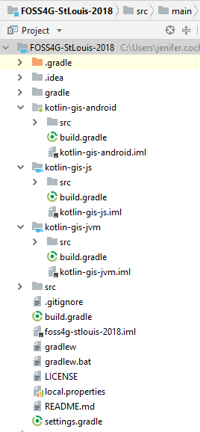
Multiplatform Project Structure
Root
Platform JS Module: Kotlin-js
src/main/kotlin
Platform JVM Module: Kotlin-jvm
src/main/kotlin
Common Module: src/main/kotlin
Regular Module: Kotlin-android
src/main/kotlin
Slides & Code: https://github.com/GitHubRGI/FOSS4G-StLouis-2018

Slide 27
What other things I learned?
Slides & Code: https://github.com/GitHubRGI/FOSS4G-StLouis-2018

Slide 28
Kotlin Native
technology for compiling Kotlin to native binaries that run without any VM
Supported Platforms
Windows (x86_64 only at the moment)
Linux (x86_64, arm32, MIPS, MIPS little endian)
MacOS (x86_64)
iOS (arm64 only)
Android (arm32 and arm64)
WebAssembly (wasm32 only)
Future:
Support for multiplatform project structure!
Common
Kotlin-Native
Kotlin-JS
Kotlin-JVM
ios
web
android
backend
Slides & Code: https://github.com/GitHubRGI/FOSS4G-StLouis-2018

Slide 29


Questions? Thanks for listening!!
Slides & Code: https://github.com/GitHubRGI/FOSS4G-StLouis-2018

